Slide 1
Pastoralist in the Modern World

Slide 2
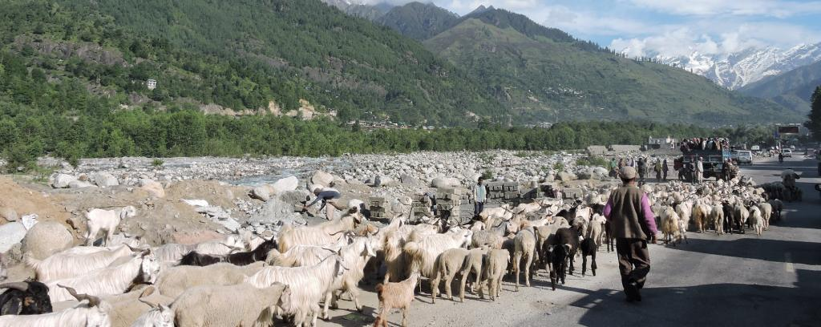
Pastoralism
It is an occupation adopted in societies in India & Africa and with passage of time though Agriculture, Industry and service sector is rapidly dominating but it has its relevance during the colonial time as well as in modern times.

Slide 3
Who are Pastoralist?
Pastoralists are those people who herds live stock, often as nomadic wanderers without a set or specified farm area.
Pastoral nomads are those who with their livestock migrate in an established territory to find pasturage for their animals with the change of the seasons.

Slide 4
Pastoralists in India
In mountains
Jammu & Kashmir - The Gujjar Bakarwals.
Himachal Pradesh – Gaddi Shepherds
Garhwal & Kumaon – Gujjar Cattle herders
Himalaya region – Bhotiyas, Sherpas, Kinnauris
In Plateaus:
Maharashtra – Dhangars, the Shepherds and also the buffalo herders
Karnataka & Andhra – The Golla, cattle herders
The Kurumas and Kurubas, sheep & goat herders

Slide 5
In Plains
UP, Punjab, Rajasthan, MP, Maharashtra - The Banjaras.
In Deserts:
Rajasthan– Raikas, the camel herder
Maru Raikas, sheep & goat herders
In Swampy areas:
Rann of Kutch– Maldhari herders

Slide 6
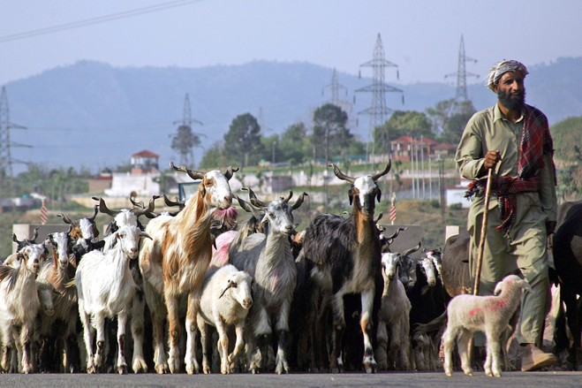
The Gujjar Bakarwals of Jammu & Kashmir
They move in groups up and down known as “Kafila”.
Their movements are governed by cold and snow.
In the winter season they moved down to the low hills of the Shivalik range of the Himalayas.

Slide 7
The Gaddi Shepherds of Himachal Pradesh
They spent their winter in the low Shivalik hills and in summer, in Lahul & Spiti region of Himachal Pradesh.
When snow melted they move to the summer meadows on high mountains.

Slide 8
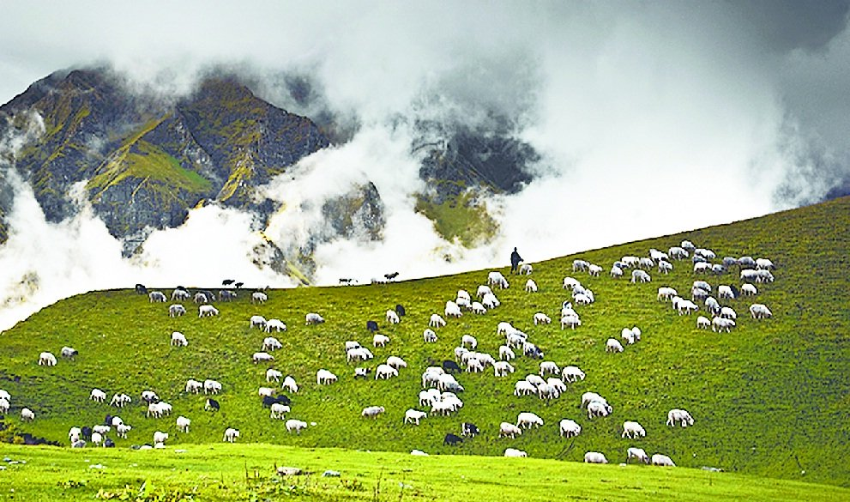
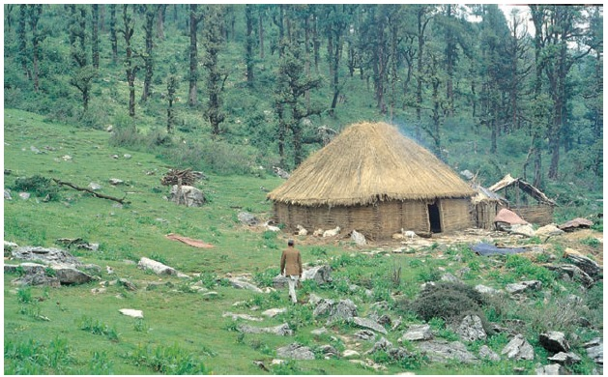
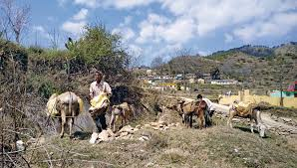
The Gujjar Cattle herders of Garhwal & Kumaon
They spent their summer in the Bugyals (vast meadows in the high mountains) and their winters in the Bhabar (a dry forested area below the foot hills of Garhwal & Kumaon)

Slide 9
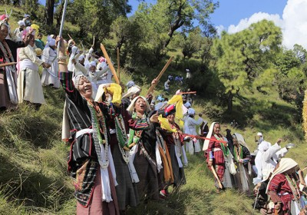
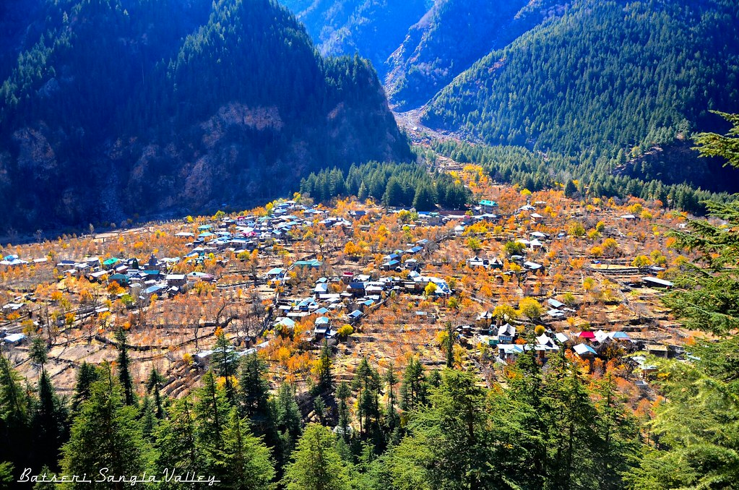
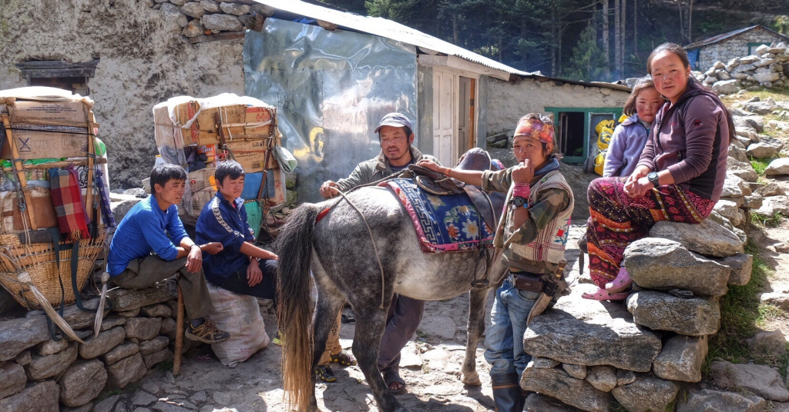
The Bhotiyas, Sherpas, Kinnauris of the Himalaya region
They follow the cyclic movements according to the seasonal changes and makes best use of the available pastures at different places in that region.

Slide 10
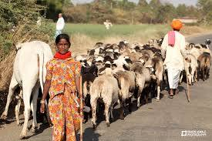
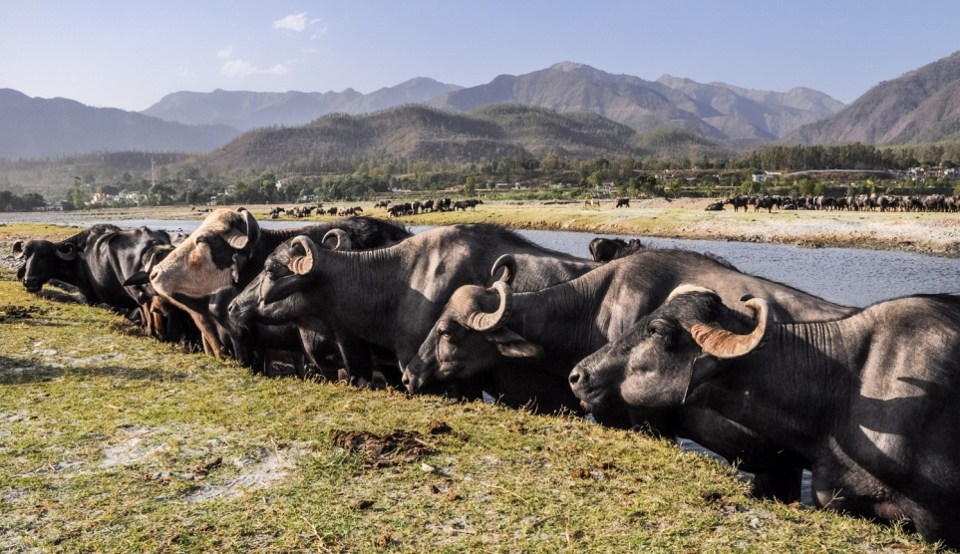
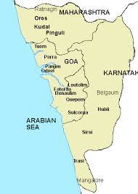
The Dhangars of Maharashtra
They stay in the central plateau during the monsoon.
In October they used to move with their herds towards Konkan region and manured the fields laying vacant between the Khariff harvest and beginning of Rabi crop.
They retreat back to Maharashtra as soon as the monsoon occurs.

Slide 11
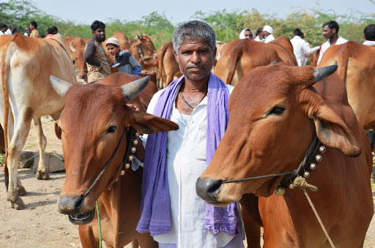
The Banjaras of UP, Punjab, Rajasthan, MP, Maharashtra
They used to move to different places in such of good pasture land even long distances.
They also sell plough cattle and other goods to villagers in exchange for grain & fodder.

Slide 12
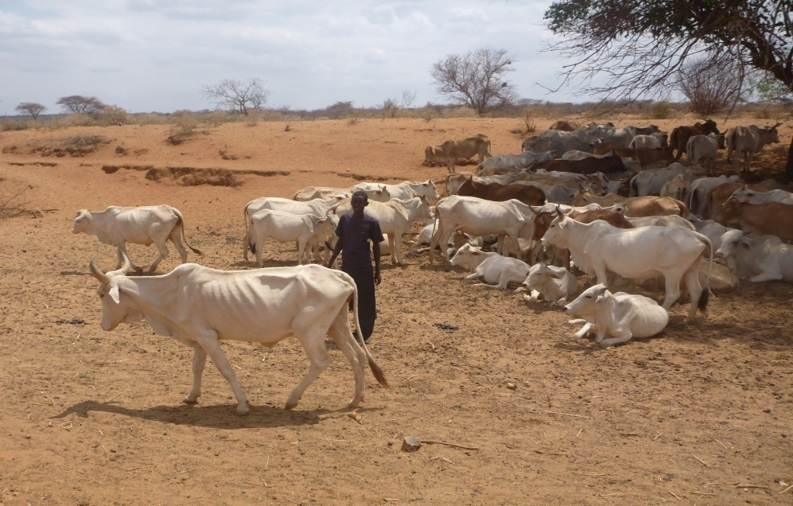
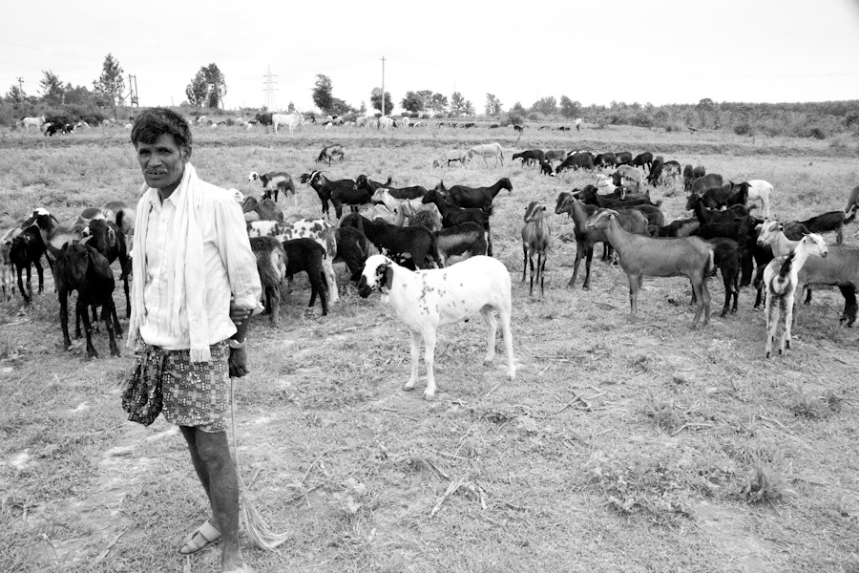
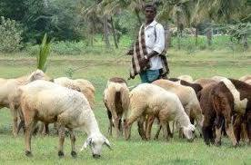
The Gollas, the Kurumas and Kurubas of Karnataka & Andhra Pradesh
Normally Gollas herd cattle
Gollas used to live near the woods and in the dry periods they move to the coastal tracts.
The Kurumas and Kurubas reared sheep and goats and sold woven blankets.
They used to live near the woods, cultivated small patches of land and engaged in a variety of petty trades.

Slide 13
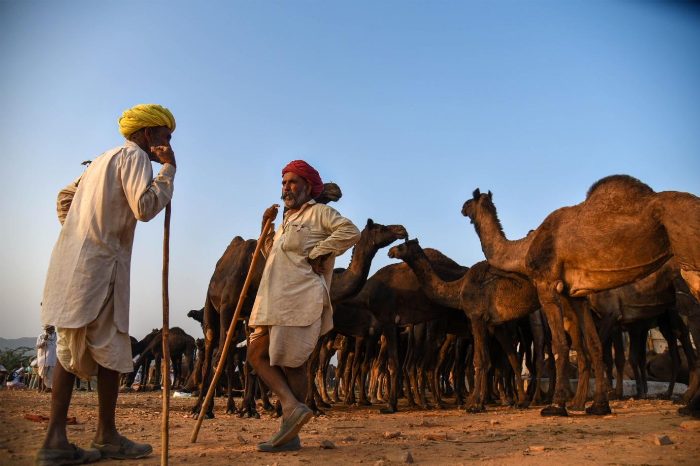
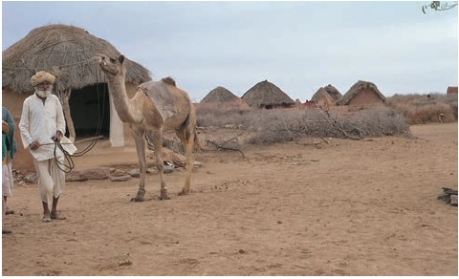
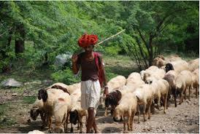
The Raikas of Rajasthan
They combined cultivation with pastrolism.
During monsoons the Raikas of Barmer, Jaisalmer, Jodhpur and Bikaner stayed in their home villages where pasture was available.
When their grazing ground becomes dry they move to new and greener pastures.
The Maru Raikas herded camels and another group herd sheep & goat.
The Maru Raikas settlement is called a Dhandi.

Slide 14
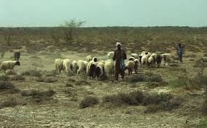
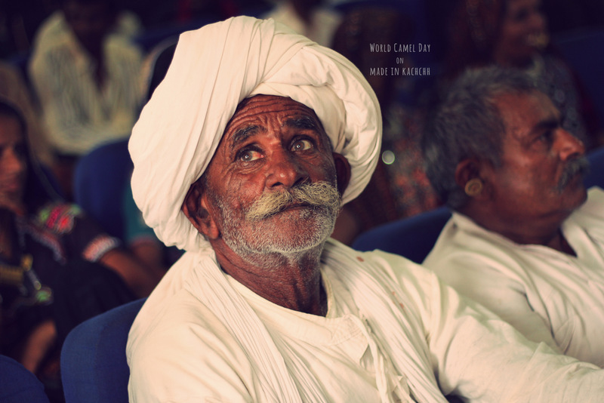
The Maldhari herders of Rann of Kutch in Gujrat
They are usually rearing sheep
Their movement is also according to the seasonal cycle of nature in that area.
They used move in search of pasture from one area to the other.

Slide 15
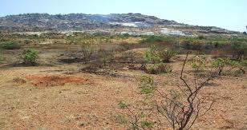
Changes in Pastoral life under Colonial Rule
Various laws were enacted to bring Pastures and the pastoralists under colonial control.
Wasteland rules brought all uncultivated land including grazing land, forests etc directly under government control.
Grazing lands were transformed to cultivated lands from which land revenue was collected by the British government.
Some grazing lands were given on auction to select individuals, later became village headman from whom money was collected.

Slide 16
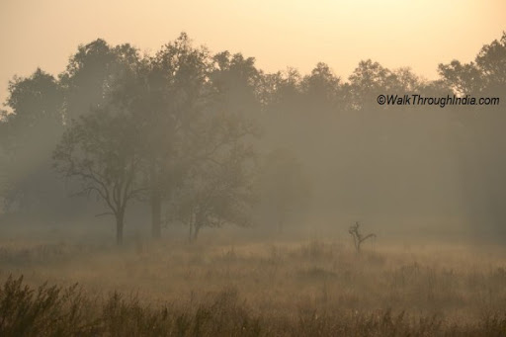
Forest Acts
Through the Forest Acts entire forest area was classified into two categories viz. Reserved forest, where entry was completely prohibited and Protected forest where entry was allowed for observance of customary rights with strict monitoring of the movement of Pastoralist by British Forest officer.
Violation of forest act was attracting financial penalty and other harassment.

Slide 17
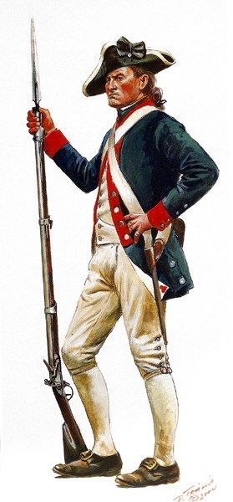
Criminal Tribes Act, 1871
Nomadic Pastoralists were subjected to suspicion by the British Officials as they have no specific identity or permanent address of residence.
They are suspected as criminals and to regulate their movement and activities the Criminal Tribes Act, 1871 was enacted.
A vigil watch was kept on them by village police.

Slide 18
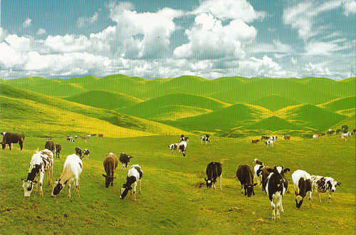
GRAZING TAX
-The colonial government imposed grazing tax on the pastoralist which was frequently hiked.
Collection grazing tax was given on auction to contractors to enhance the revenue.
Sometimes the British officials also involved in collecting this tax by issuing individual ‘pass’ to the pastoralist for getting more income.

Slide 19
Impact of colonial policies
Severe shortage of pasture
Intensive over grazing on the same pasture land reduced the quality of pasture.
Scarcity of fodder led to ill-health, disease and death of the cattle flock.
Reduction in number of cattle, change of cattle movement to new areas.
Adoption of settled life and engagement in other professions, trade and even labour work by the pastoralists

